Slide 1
AWAC: Accelerating Online Reinforcement Learning with Offline Datasets
Nair, Ashvin, Abhishek Gupta, Murtaza Dalal, and Sergey Levine. "Awac: Accelerating online reinforcement learning with offline datasets." arXiv preprint arXiv:2006.09359 (2020).
Sushanth Doddabasappa Steeve Daniel Mahum Pervez Siddharth Jain ID: 1225757429 ID:1219930205 ID: 1225782012 ID:1226137070 sdoddab2@asu.edu sdanie20@asu.edu mpervez@asu.edu sjain238@asu.edu

Slide 2
ABSTRACT
Reducing the time required to learn a range of robotic skills to practical time-scales by incorporating prior offline data along with online tuning in Reinforcement Learning
Advantage Weighted Actor Critic (AWAC) Algorithm results in rapid learning of practical applications
Rapid learning of robotic skills occur with a combination of prior demonstration data and online experience.
Validated on a robotic control task enabling wider array of robotic applications.
Simulation of the task resulted in satisfactory success rate and average return compared to the results proposed by the paper

Slide 3
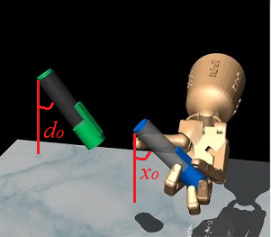
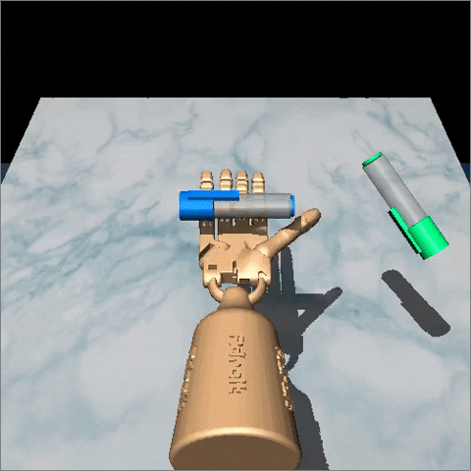
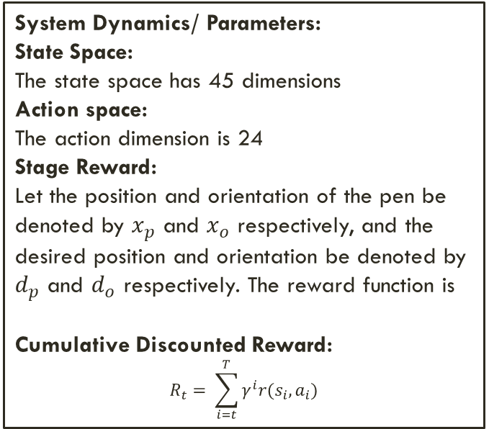
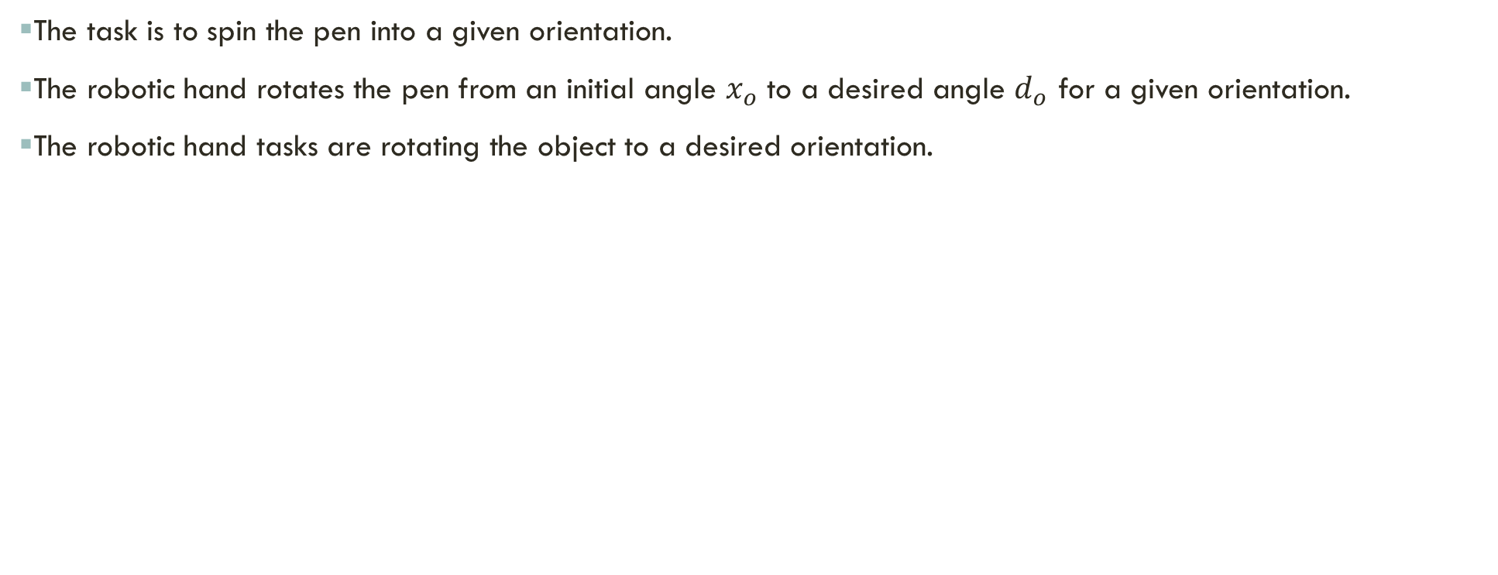
INTRODUCTION: Dexterous Manipulation with a Robotic Hand
The task is to spin the pen into a given orientation.
The robotic hand rotates the pen from an initial angle $x_{o}$ to a desired angle $d_{o}$ for a given orientation.
The robotic hand tasks are rotating the object to a desired orientation.
System Dynamics/ Parameters:
State Space:
The state space has 45 dimensions
Action space:
The action dimension is 24
Stage Reward:
Let the position and orientation of the pen be denoted by $x_{p}$ and $x_{o}$ respectively, and the desired position and orientation be denoted by $d_{p}$ and $d_{o}$ respectively. The reward function is
Cumulative Discounted Reward:
$$R_{t}= \sum_{i=t}^{T}{γ^{i}r(s_{i},a_{i})}$$
Figure 1: Controlling a 5-fingered robotic hand to pick up a pen and spin it into a given orientation [1]

Slide 4
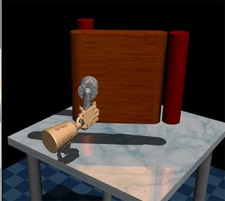
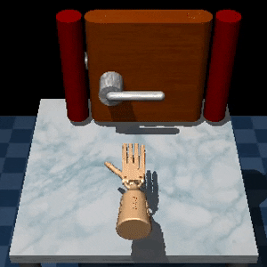
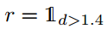
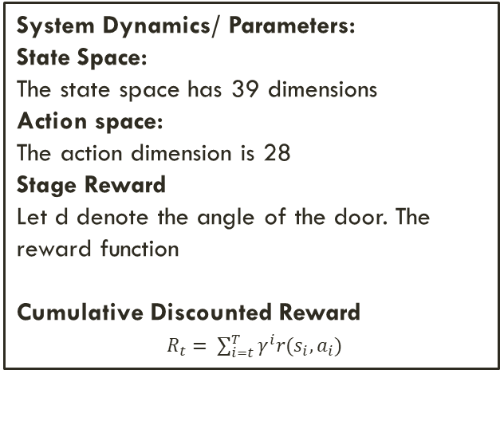
INTRODUCTION: Dexterous Manipulation with a Robotic Hand
The task is to open a door, which requires first twisting a latch
The robotic hand reaches for the door handle, grabs it and turns it in a clockwise direction.
The door is then swung opened and the task is completed as soon as the door touches the door stopper at the other end
The task is reaching, grabbing, twisting a latch and opening a door in clockwise direction
System Dynamics/ Parameters:
State Space:
The state space has 39 dimensions
Action space:
The action dimension is 28
Stage Reward
Let d denote the angle of the door. The reward function
Cumulative Discounted Reward
$R_{t}= \sum_{i=t}^{T}{γ^{i}r(s_{i},a_{i})}$
Figure 2: Opening a door, which requires first twisting a latch[1]

Slide 5
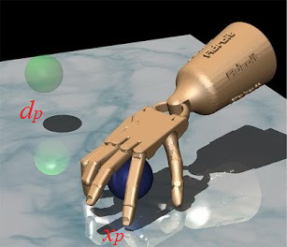
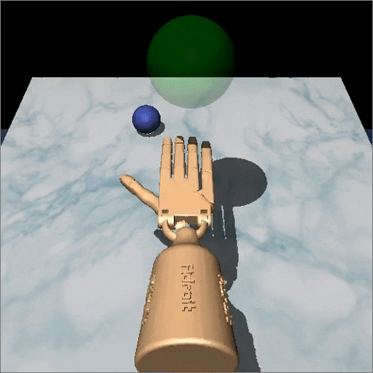
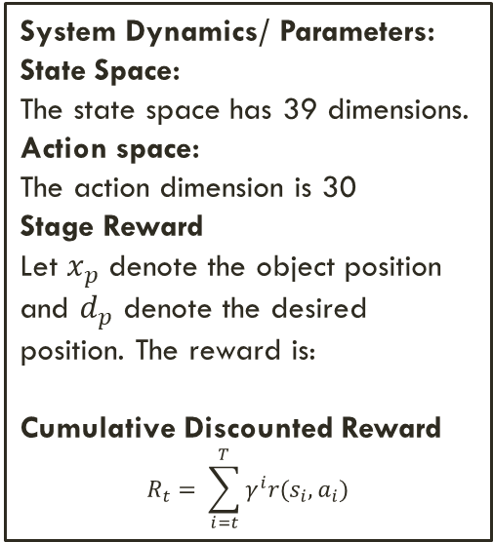
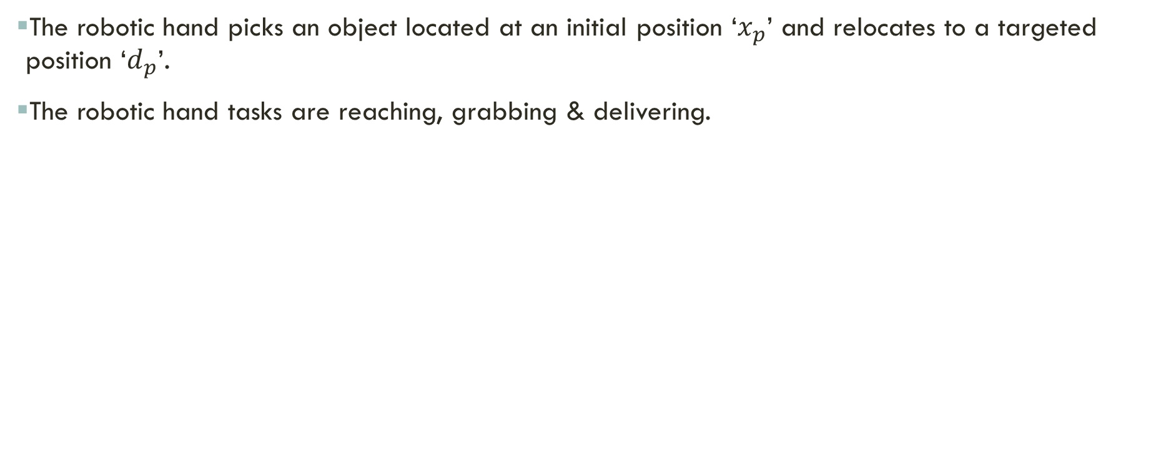
Dexterous Manipulation with a Robotic Hand
The robotic hand picks an object located at an initial position ‘$x_{p}$’ and relocates to a targeted position ‘$d_{p}$’.
The robotic hand tasks are reaching, grabbing & delivering.
System Dynamics/ Parameters:
State Space:
The state space has 39 dimensions.
Action space:
The action dimension is 30
Stage Reward
Let $x_{p}$ denote the object position and $d_{p}$ denote the desired position. The reward is:
Cumulative Discounted Reward
$$R_{t}= \sum_{i=t}^{T}{γ^{i}r(s_{i},a_{i})}$$
Figure 3: Controlling a 5-fingered robotic hand to reposition an object from initial to targeted spot [1]

Slide 6
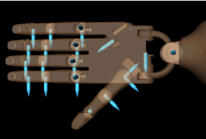
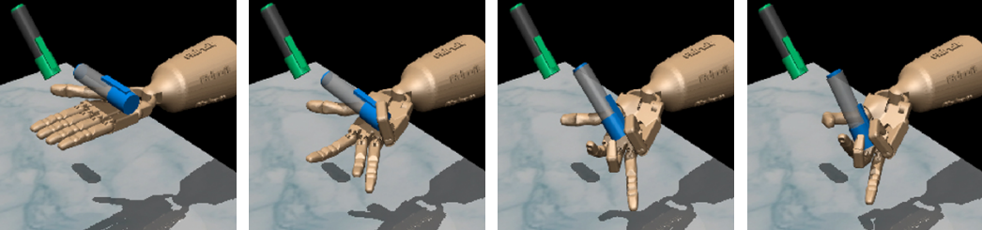
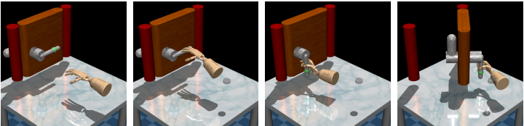
interpretation of action/state dimensions and rewards
Task 2: open a door by first twisting a latch
Task 1: pick up a pen and spin a pen into a given orientation.
Action Dimensions:
24-DoF anthropomorphic robotic hand for dexterous manipulation.
The first, middle, and ring fingers have 4 DoF.
Little finger and thumb have 5 DoF.
The wrist has 2 DoF.
State Space Dimensions:
State Space of 45 dimensions consisting of:
24 Joint angles of the hand
6 End Effector position and orientation
6 Object position and orientation
6 Target position and orientation
3 Rotation of pen
Action Dimensions:
28-DoF
The first, middle, and ring fingers have 4 DoF.
Little finger and thumb have 5 DoF.
The wrist has 2 DoF.
The door and handle has 4 DoF
State Space Dimensions:
State Space of 39 dimensions consisting of:
24 Joint angles of the hand
6 End Effector position and orientation
3 Object position
3 Target position
3 Rotation of Door
Figure 4: 24 degree of freedom robotic hand. The blue arrows mark the position of the joints and corresponding position actuator.
Figure 5: Controlling a 5-fingered robotic hand to pick up a pen and spin it into a given orientation [1]
Figure 6: Opening a door, which requires first twisting a latch[1]

Slide 7
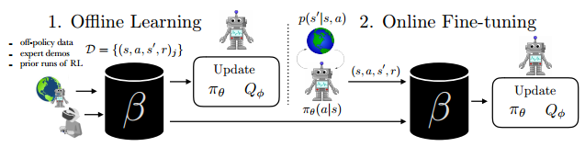
Introduction
Deploys offline pre-training with online fine-tuning compared to the standard RL paradigm trained from scratch
Offline RL learns optimal policies from arbitrary off-policy utilizing prior data/ demonstrations benefits
Depending on the quality of available data, offline training is supported with targeted online improvement
Figure 7. The problem of accelerating online RL with offline datasets. In (1), the robot learns a policy entirely from an offline dataset. In (2), the robot gets to interact with the world and collect on-policy samples to improve the policy beyond what it could learn offline. [1]

Slide 8
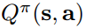
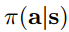
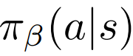
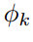
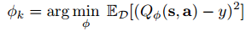
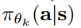
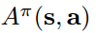
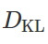
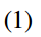
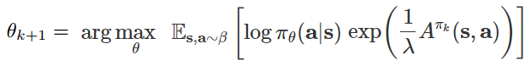
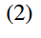
METHOD: COST FUNCTIONS
Notations:
Action-value function:
Rewards:
Discount factor:
Dynamics:
Policy:
Past policies:
Q-function parameters: Actor:
Critic:
Advantage:
Divergence Operator:
Lagrange multiplier λ = 0.3
The AWAC algorithm is composed of policy evaluation and policy improvement.
During policy evaluation phase, the critic is estimated for the current policy π.
Minimize the Bellman error with respect to Q-function parameters
For data efficiency, AWAC trains the critic offline using Dynamic Programming
To avoid bootstrapping problem along with ensuring stable data distribution modelling, constraints are added on the policy improvement update
In policy evaluation, AWAC optimizes the policy to maximize the advantage at every state given as
Compute the optimal solution for eq and project our policy onto it, which results in the following actor update :

Slide 9
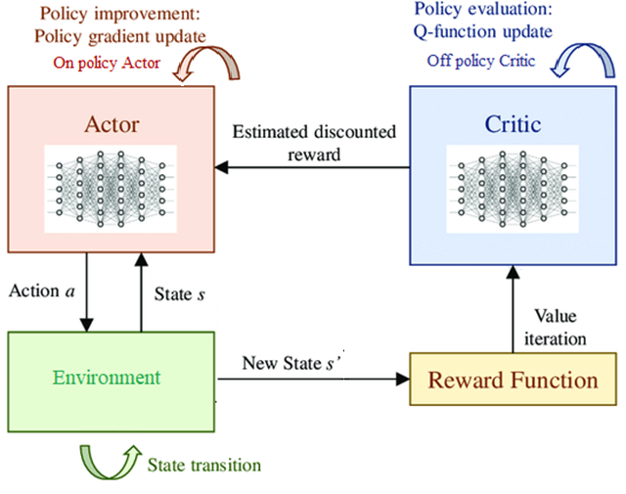
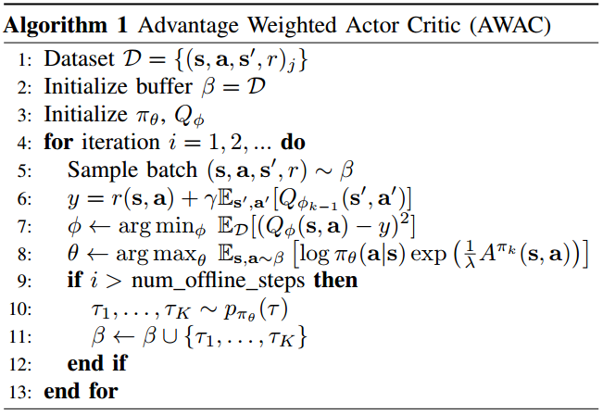
Implementation: ALGORITHM
Figure 8. Diagram of the Advantage Weighted Soft Actor-Critic (AWAC) based algorithm for the real-time control in dexterous Manipulation with a Robotic Hand
Figure 9. AWAC algorithm pseudocode [1]

Slide 10
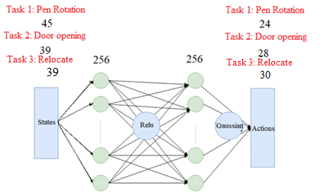
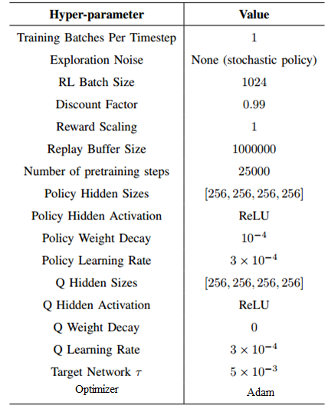
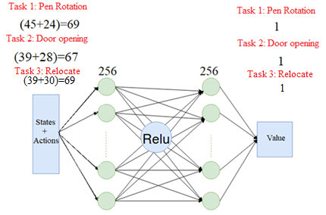
IMPLEMENTATION: HYPERPARAMETERS & Neural net architecture
Figure 10: Figure 10: Critic Network Architecture to estimate Q values/ V values [2,3]
Figure 11: Actor Network Architecture incorporating offline and online learning to estimate policy functions [2]
Table 1: Hyperparameters used for RL Experiments [1]

Slide 11
IMPLEMENTATION: SYSTEM SETUP, DATA SET & TRAINING
SYSTEM SETUP
Part 1: Setting up MuJoCo (Physics simulator) for RL by installing mjrl
DATA SET & TRAINING
Dataset for all the three hand manipulation tasks can be found here
sudo apt-get install libgl1-mesa-dev libgl1-mesa-glx libglew-dev libosmesa6-dev build-essential libglfw3
conda env create -f setup/env.yml
source activate mjrl-env
pip install -e .
Part 2: Setting up MuJoCo Environments which contains Dexterous Hand Manipulation Suite Tasks
git clone --récursive https://github.com/vikashplus/mj_envs.git
pip install -e .
Part 3: Setting up hand_dapg package that interfaces training algorithms on the hand manipulation tasks
Part 4: Setting up AWAC repository and installing UC Berkeley’s rlkit packages
git clone https://github.com/rail-berkeley/rlkit.git
Modifications were made to the training script awac1.py (discussed further in the challenges section)
Once modifications were incorporated & dataset path, and hyperparameters were updated in the rlkit/launchers/experiments/awac/awac_rl.py file, the AWAC training can be commenced using the command: python rlkit/examples/awac/hand/awac1.py

Slide 12
CHALLENGES AND RESOLUTIONS
The training script was designed with n_seeds = 3 to run three training parallel experiments on 3 Amazon Web Services ec2 machines. The training script was restructured to accommodate local training and we were able to reproduce results with just n_seeds = 1
The requirements listed for the environment setup were incomplete. For example, python packages such as multiworld, opencv, pygame, flask were not included in the setup.py file in the repositories. By parsing the logs, the missing packages were installed. We were cautious while installing these packages and ensured that they don’t break the existing conda environment by using the command: pip install –no-dependencies <package_name>
Deprecated packages such as path and multiworld raised “module not found” errors. path package was replaced with pathlib in all such instances. mutiworld was installed from the source

Slide 13
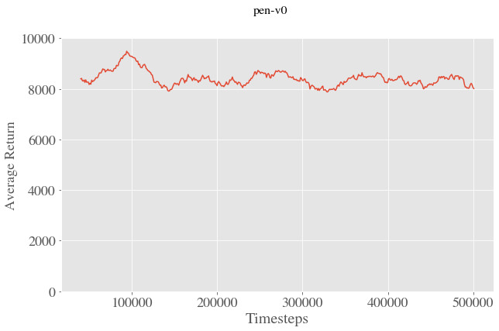
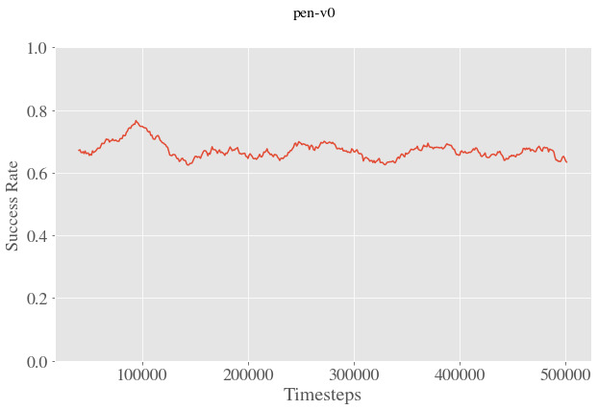
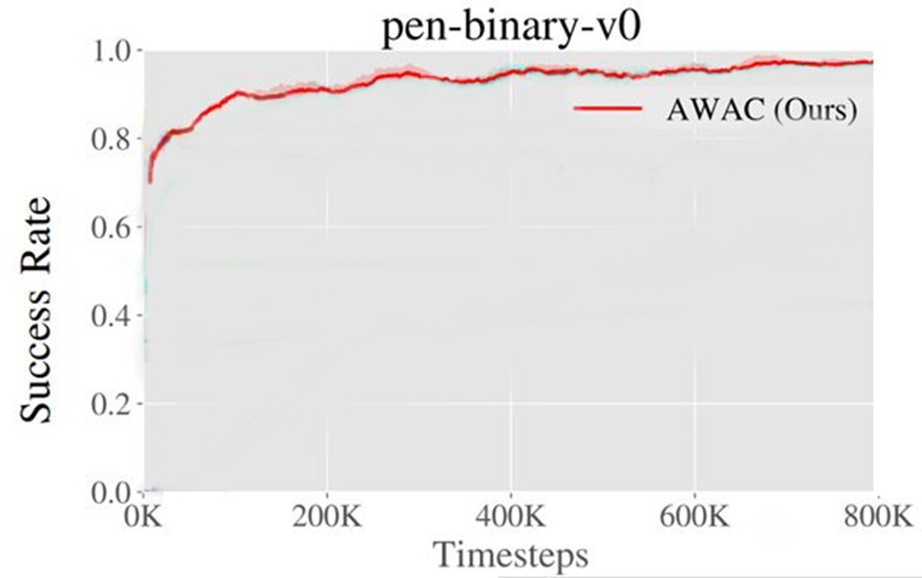
REORIENTATION TASK RESULTS: AVERAGE RETURN & SUCCESS RATE
The simulated average return is presented for our implementation for the Reorientation task
Performance Parameters | Values
Average of all Returns | 8383.55
Deviation Average Return | 2880
Number of episodes | 500
Time steps per episode | 1000
Figure 12: Average Return versus iterations for our implementation of AWAC
Table 2: Performance parameters observed for average return
The comparison of success rates are given for our implementation and the paper
Figure 13: Success Rate versus iterations for our implementation
Figure 14: Success Rate versus iterations from paper

Slide 14
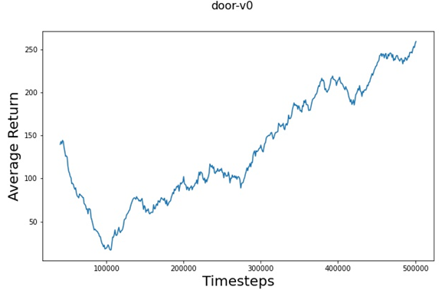
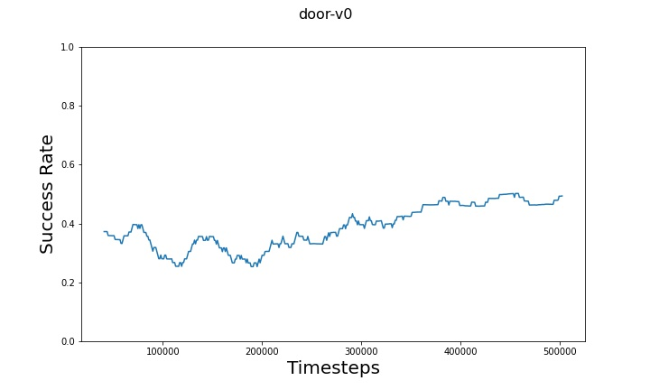
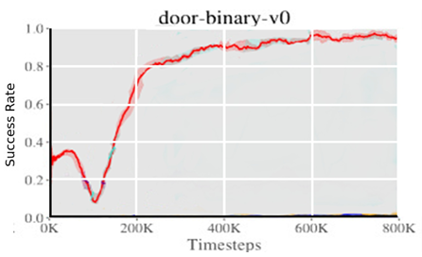
DOOR OPENING TASK RESULTS: AVERAGE RETURN & SUCCESS RATE
The simulated average return is presented for our implementation for the Door Opening task
Performance Parameters | Values
Average of all Returns | 140.84
Standard Deviation of Average Return | 108.10
Number of episodes | 500
Time steps per episode | 1000
Figure 15: Average Return versus iterations for our implementation of AWAC
Table 3: Performance parameters observed for average return
The comparison of success rates are given for our implementation and the paper
Figure 16: Success Rate versus iterations for our implementation
Figure 17: Success Rate versus iterations from paper

Slide 15
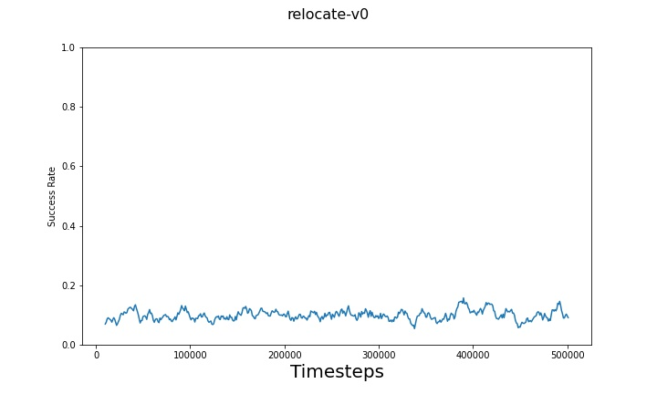
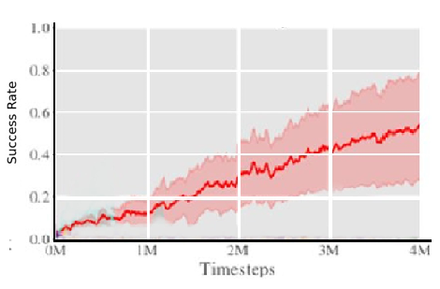
RELOCATION TASK RESULTS: AVERAGE RETURN & SUCCESS RATE
The comparison of success rates are given for our implementation and the paper
Figure 18: Success Rate versus iterations for our implementation
Figure 19: Success Rate versus iterations from paper
Reasoning for the above performance:
We ran the task for 500,000 timesteps as compared to the 4M timesteps in the original paper; For these initial 500,000 timesteps, the performance is comparable.
As seen by the graph from the paper, we see that other algorithms such as Behavior Regularized Actor Critic (BRAC) and Advantage-Weighted Behavior Model (ABM) failed to learn the task even after 4M steps, thus showcasing the difficulty of the task.
“Most prior methods are not able to solve the harder task object relocation.” [1]

Slide 16
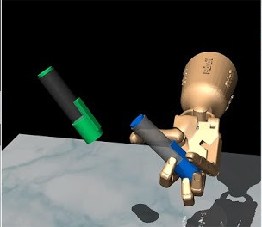
RESULTS: SIMULATION, TRAIN LOGS & MODEL ARTIFACTS
Simulation of pen reorientation task
Complete Training Logs for Pen Reorientation Task
Pen Reorientation Task: Model Artifacts
Details of our Trained Policy Being Executed/Simulated in the Pen Environment
Figure 20: Simulation of pen reorientation task

Slide 17
RESULTS: SIMULATION, TRAIN LOGS & MODEL ARTIFACTS
Simulation of door opening task
Complete Training Logs for Door Opening Task
Door Opening Task: Model Artifacts
Figure 21: Opening a door, which requires first twisting a latch[1]

Slide 18

RESULTS: SIMULATION, TRAIN LOGS & MODEL ARTIFACTS
Complete Training Logs for Relocate Task
Relocate Object Task: Model Artifacts
Figure 22: Relocate Object Task[1]

Slide 19
References
Nair, Ashvin, Abhishek Gupta, Murtaza Dalal, and Sergey Levine. "Awac: Accelerating online reinforcement learning with offline datasets." arXiv preprint arXiv:2006.09359 (2020).
Haarnoja, Tuomas, Aurick Zhou, Pieter Abbeel, and Sergey Levine. "Soft actor-critic: Off-policy maximum entropy deep reinforcement learning with a stochastic actor." In International conference on machine learning, pp. 1861-1870. PMLR, 2018.
Hasselt, Hado. "Double Q-learning." Advances in neural information processing systems 23 (2010).
Levine, Sergey, Aviral Kumar, George Tucker, and Justin Fu. "Offline reinforcement learning: Tutorial, review, and perspectives on open problems." arXiv preprint arXiv:2005.01643 (2020).
Dong, Hao, Hao Dong, Zihan Ding, Shanghang Zhang, and Chang. Deep Reinforcement Learning. Springer Singapore, 2020.
Sutton, Richard S., and Andrew G. Barto. "Introduction to reinforcement learning." (1998): 551283.
Rajeswaran, Aravind, Vikash Kumar, Abhishek Gupta, Giulia Vezzani, John Schulman, Emanuel Todorov, and Sergey Levine. "Learning complex dexterous manipulation with deep reinforcement learning and demonstrations." arXiv preprint arXiv:1709.10087 (2017).

